Slide 1


Slide 1
Post-Covid Business Recovery Analysis
(NYC)

Slide 2


Agenda
Objective
Background
Post Pandemic Travel Trends
Key Findings
Recommendations
Appendix

Slide 3
OBJECTIVE
Understand Key Insights from Pre-Covid Period (2011-2019) Data.
Post Covid Business Analysis & Growth Opportunities.
Identify Customer Preferences for Post Covid Travel Rebound.

Slide 4
Background
Given Dataset Contains:
Region - New York
Districts – 5 (Manhattan, Brooklyn, Bronx, Queen & Staten Island.
Total count of Properties: 48,895
Total number of Reviews(Bookings): 1,138,005
Assumptions:
The reviews are post-stay reviews responded within 1-2 days and hence one review can be considered as one booking.
We assumed that company progress was on track pre-covid

Slide 5
Post Pandemic Travel Trends - Airbnb Survey Findings
People will travel less for business and more for pleasure
People want travel that is affordable
People want to stay safe
People want to travel nearby, by car
More travelers will look outside top destinations and consider smaller communities
Sustainable travel is also top of mind
(Airbnb Survey) : https://news.airbnb.com/2021-travel/

Slide 6
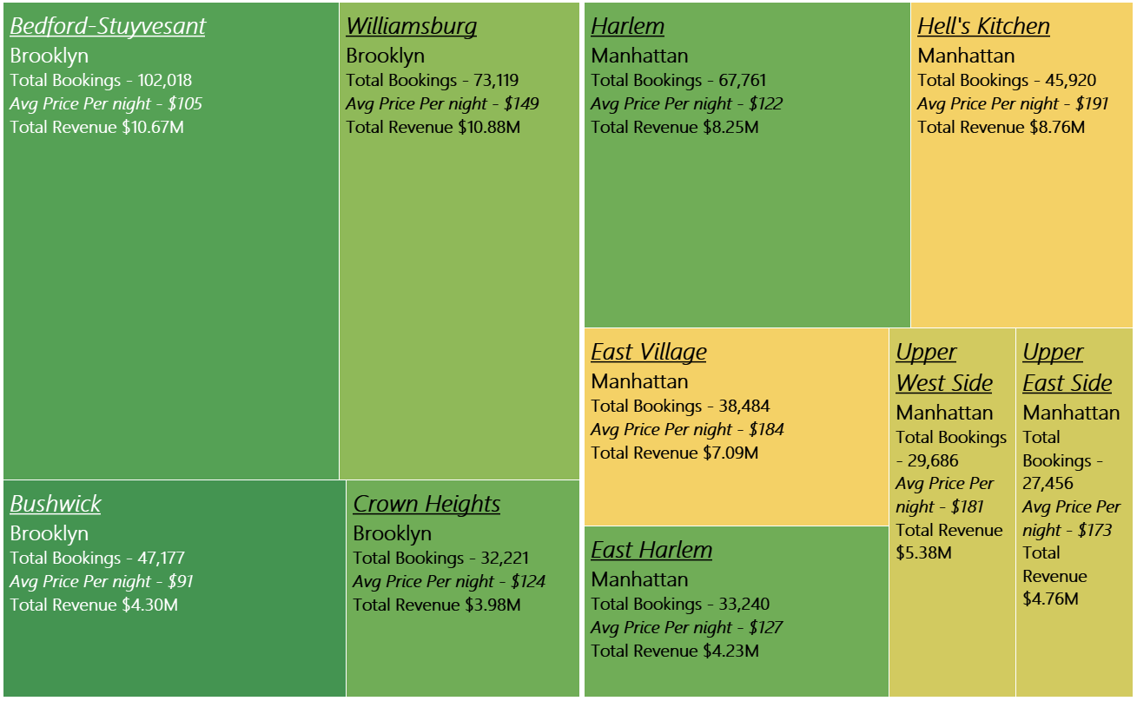

Key Findings - Neighborhoods
Brooklyn and Manhattan have the highest booking and are the most popular districts.
Bedford & Williamsburg in Brooklyn, and Harlem in Manhattan had the highest bookings in 2019.
Hell’s Kitchen & East Village in Manhattan reported higher revenue with lower bookings.
Popular Neighboorhoods
Brooklyn
486K
$118
Manhattan
454K
$180
Queens
157K
$95
Bronx
27K
$85
Staten Island
12K
$99
Total Bookings
Avg Price Per Night

Slide 7
Recommendation
Focus on Manhattan and Brooklyn to drive revenue and promote neighborhoods such as Bedford and Williamsburg in Brooklyn along with Harlem & Hell’s Kitchen in Manhattan to online users searching for stay in NYC.
Analyze and identify properties that have relatively high number bookings even with higher price per night to maximize the revenue
Identify properties that are in good neighborhoods within Bronx and Queens and are affordable.

Slide 8
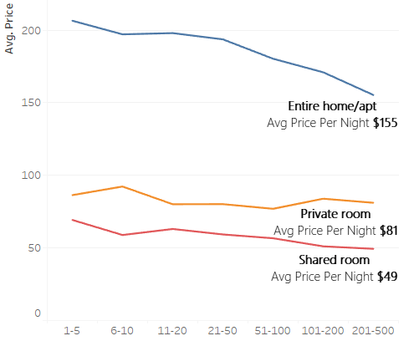
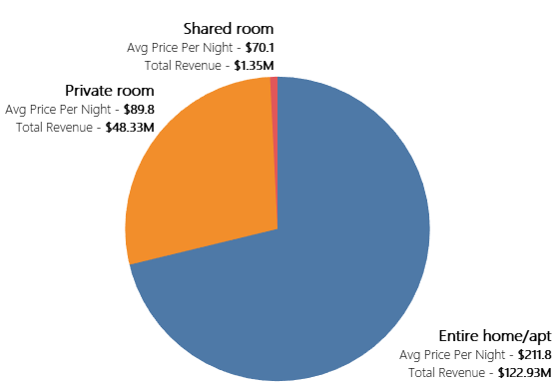
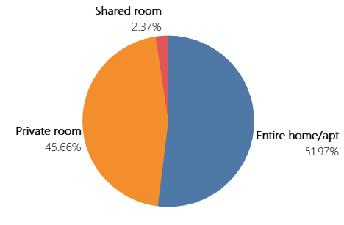
Key Findings – Room Types
The room types Entire Home/Apt and Private Rooms are preferred over shared rooms.
Entire Home/Apt even with higher Avg Price Per Night contributes to 52% of the bookings and 71% of the total revenue.
Properties with most bookings had the Avg Price Per Night of $155 for Entire Home/Apt, $81 for Private Room and $49 for Shared Room.
Preferred Room Types
Avg Price of properties based on # of Bookings
Percentage Share of Total Properties
Percentage Share of Total Revenues
Number of bookings

Slide 9
Recommendation
Due to covid related safety guidelines and social distancing, the demand for Entire Home/Apt will continue to rise, followed by Private Rooms. There’ll be even lesser demand for Shared Rooms going forward.
Identify properties that offer similar room type and experience from the same neighborhood but are charging much higher price per night. This data will help the hosts to adjust their prices accordingly.
Analyze further to identify if how many private rooms is being offered by a single host in the same property. These hosts can be advised to convert their room type to Entire Home/Apt instead of offering Private Rooms.

Slide 10
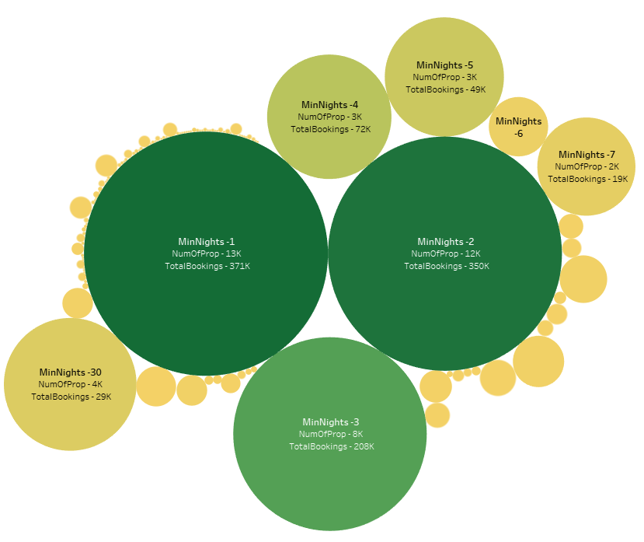
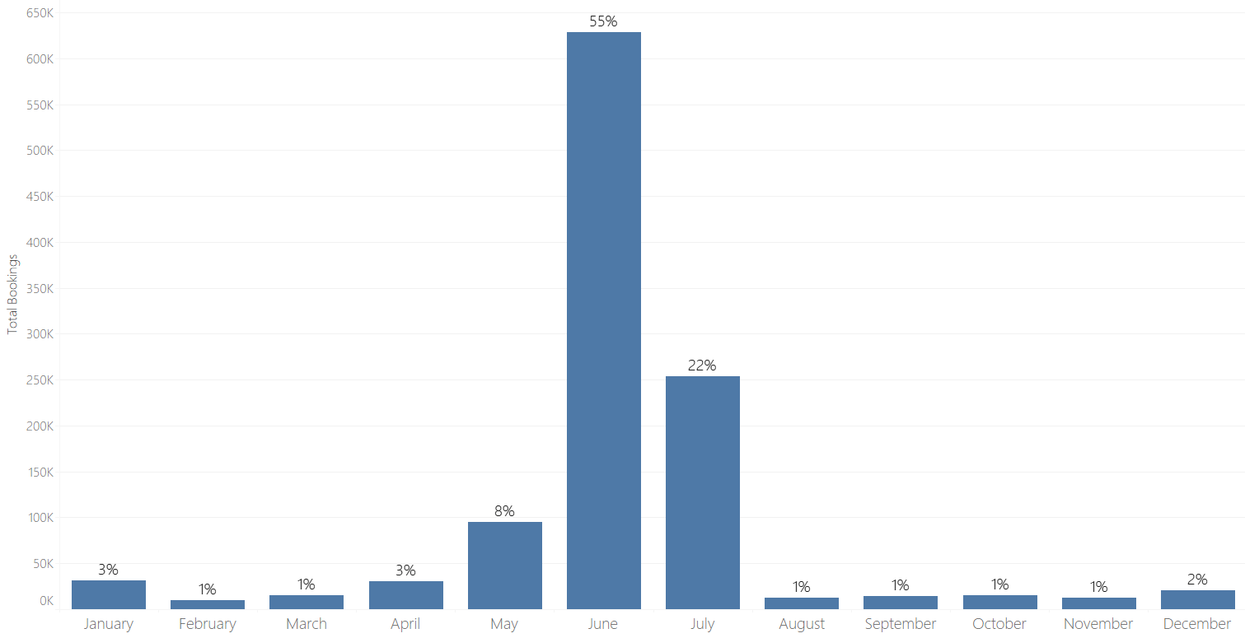

Key Findings – Other Preferences
68% of the properties have Minimum Nights requirement of less than 3 days
64% of the Bookings are for stays less than 2 days.
85% of the Bookings are in the summer months of May, June & July
Other Preferences
Preference for Minimum Night
Month-wise Booking Preference

Slide 11
Recommendation
Based on the Airbnb Survey Results, people are looking for extended stays and hence we should see an uptick in bookings for more than 7 nights and even an increase for 30+ nights. Better rates should be provided for longer stays.
As most of the bookings have been for 1, 2 or 3 nights, we need to advise the hosts that have kept their minimum stay for more than 4 days to allow even shorter duration stays to increase on bookings.
Further analyze the monthly trending data to understand how the bookings can be increased through the rest of the year.

Slide 12

Surprising Insights
About 10,000, 20% of all the properties listed for NYC, have reported 0 bookings.
There are about 5000 properties that show 0 availability and had 0 bookings. These are either hidden or zombie listings.
There are 438 properties which require a minimum stay of 60 nights or more and 40 of those require 365 nights or more

Slide 13

Slide 10
THANK YOU
Darshan Lama
Chaitanya Kumar

Slide 14
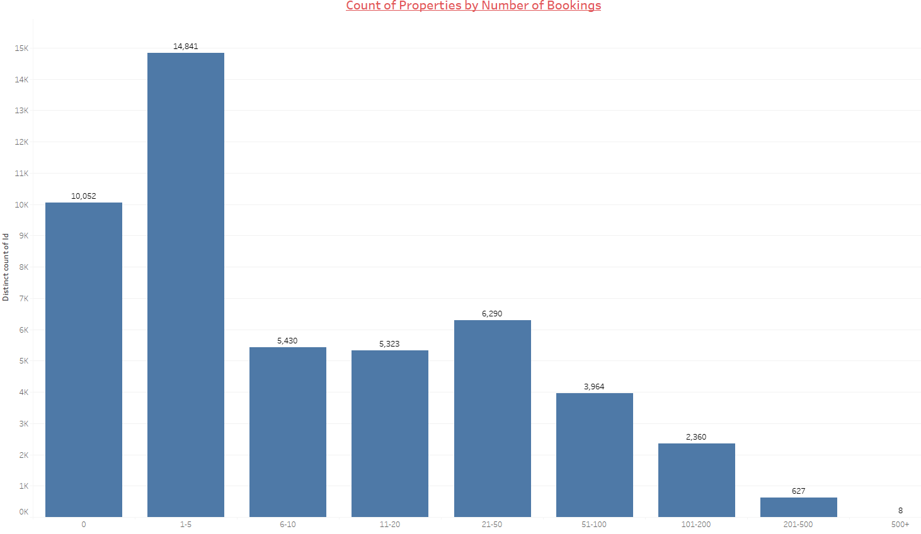
Appendix
About 10,000, 20% of all the properties listed for NYC, have reported 0 bookings.

Slide 15
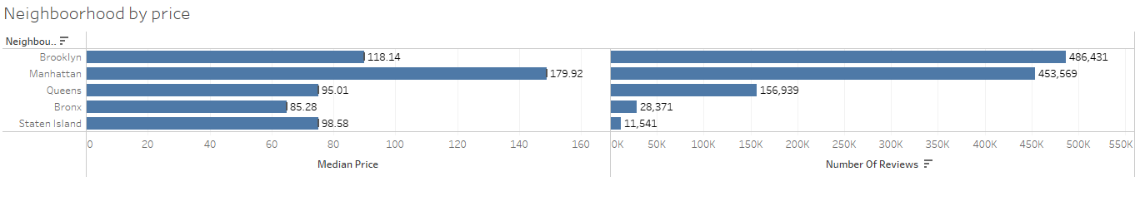
Appendix

Slide 16
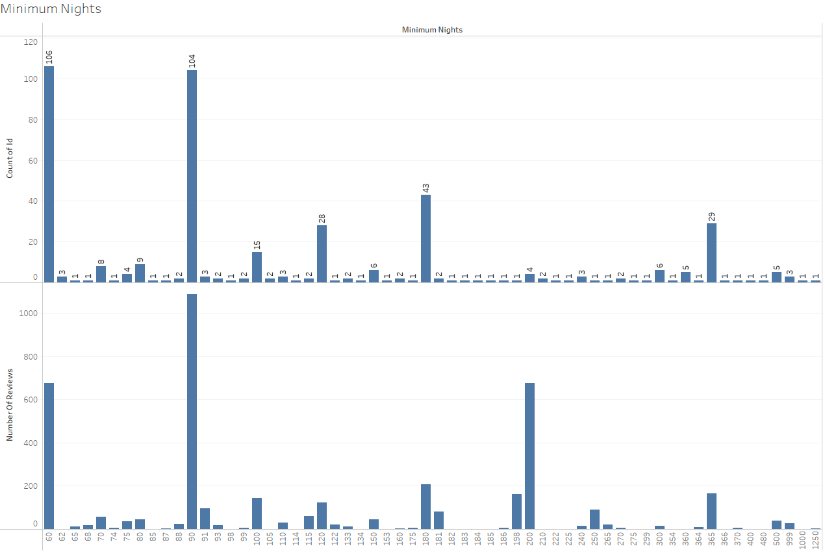
Appendix

